Slide 1

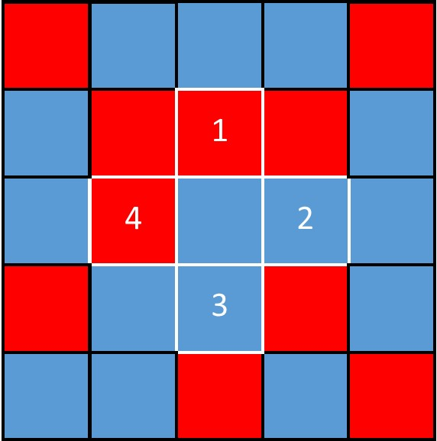
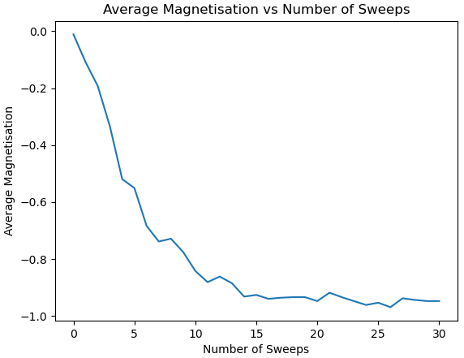
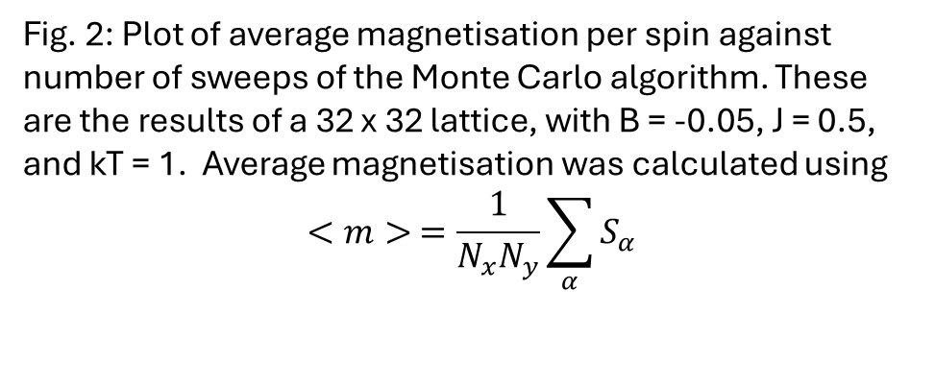
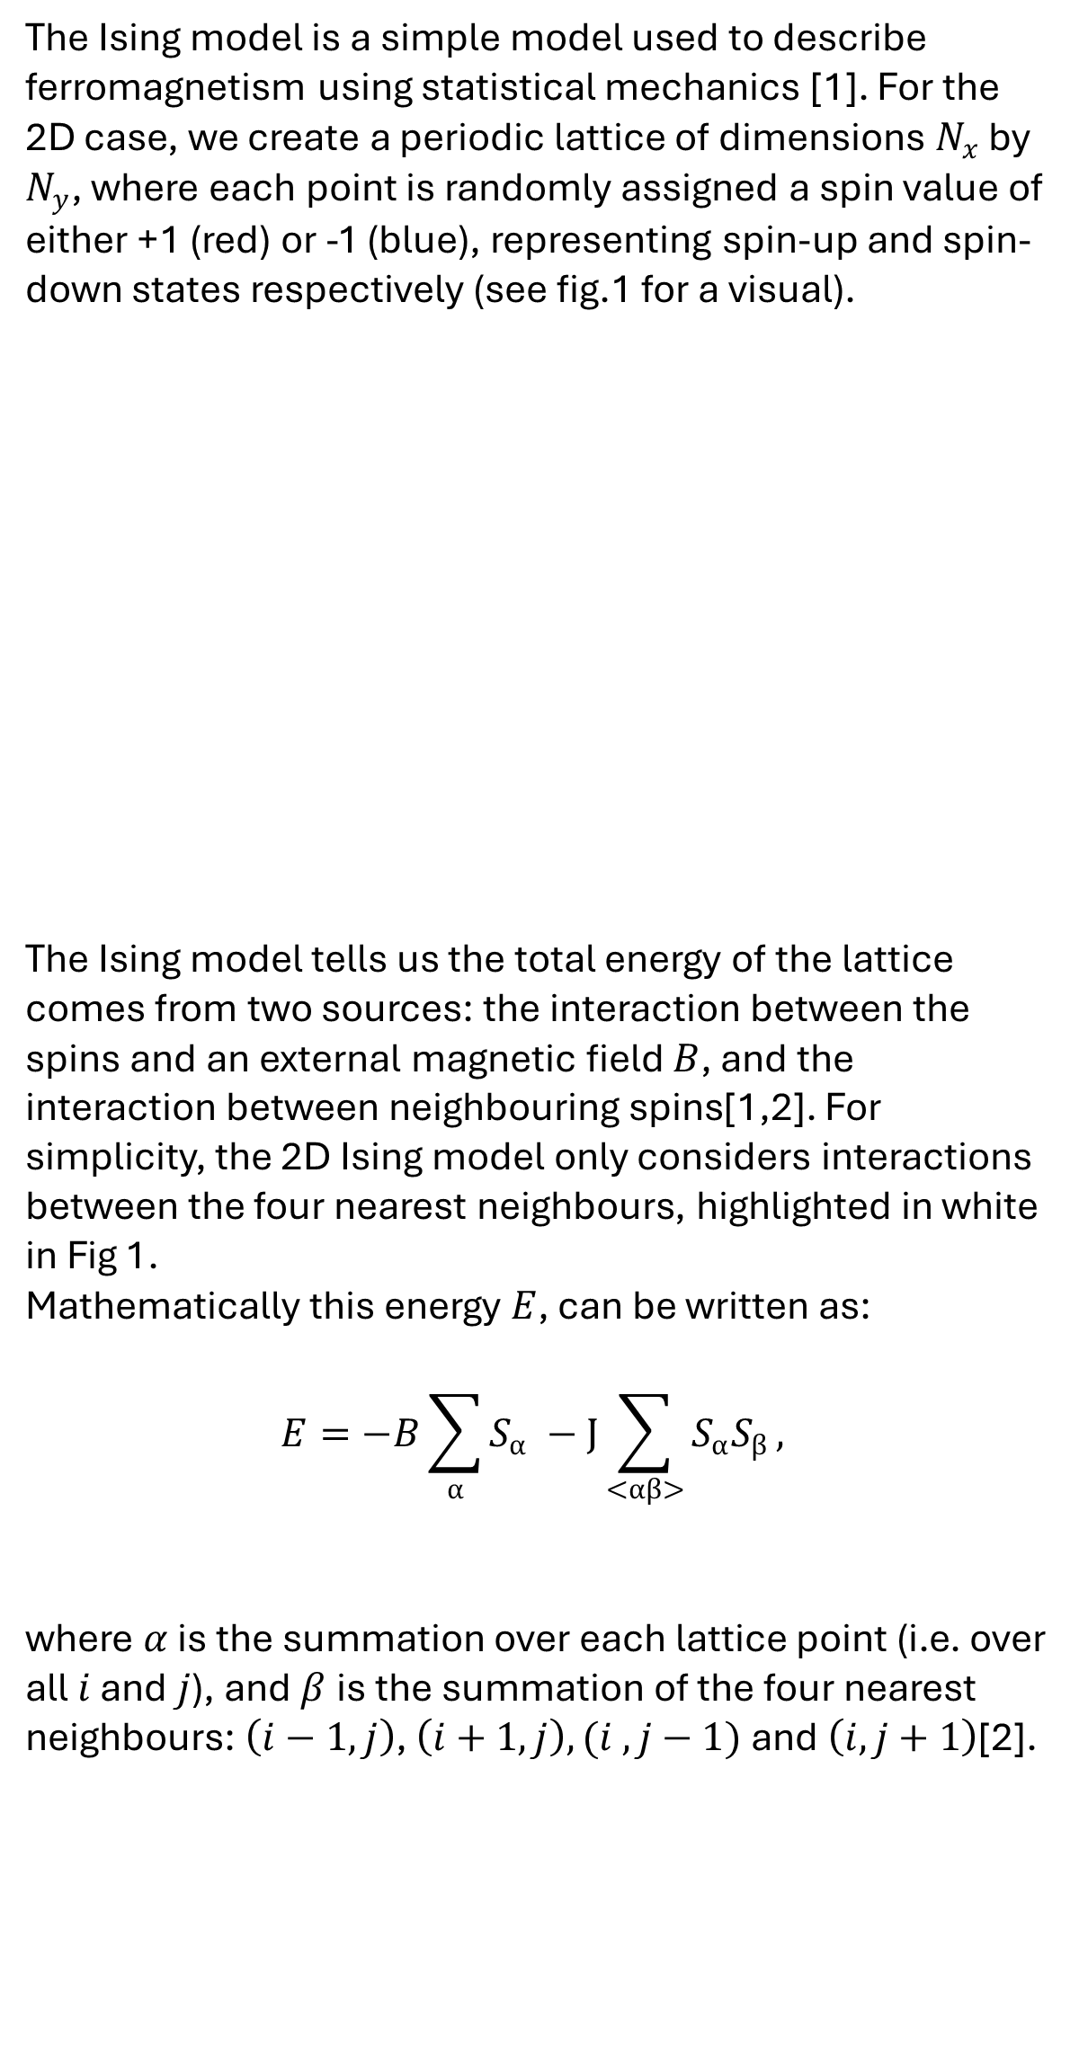
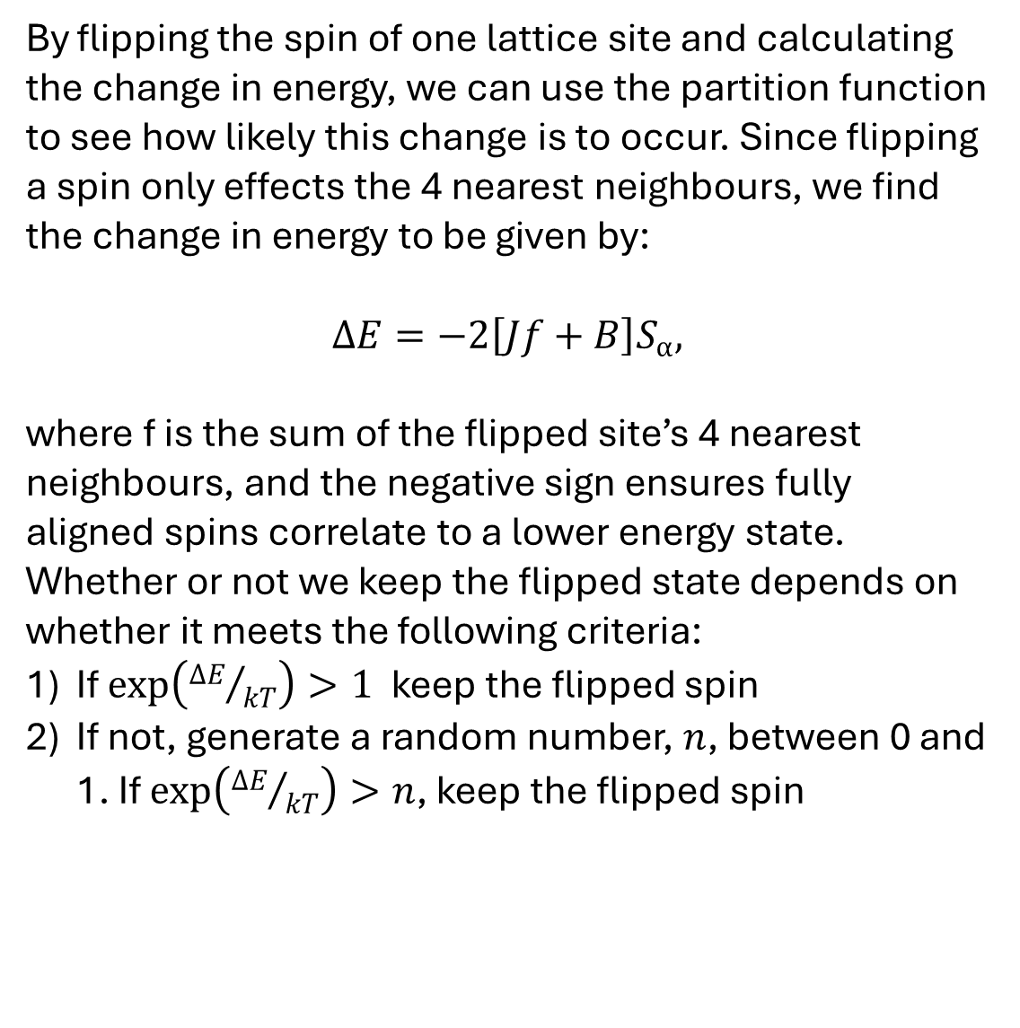
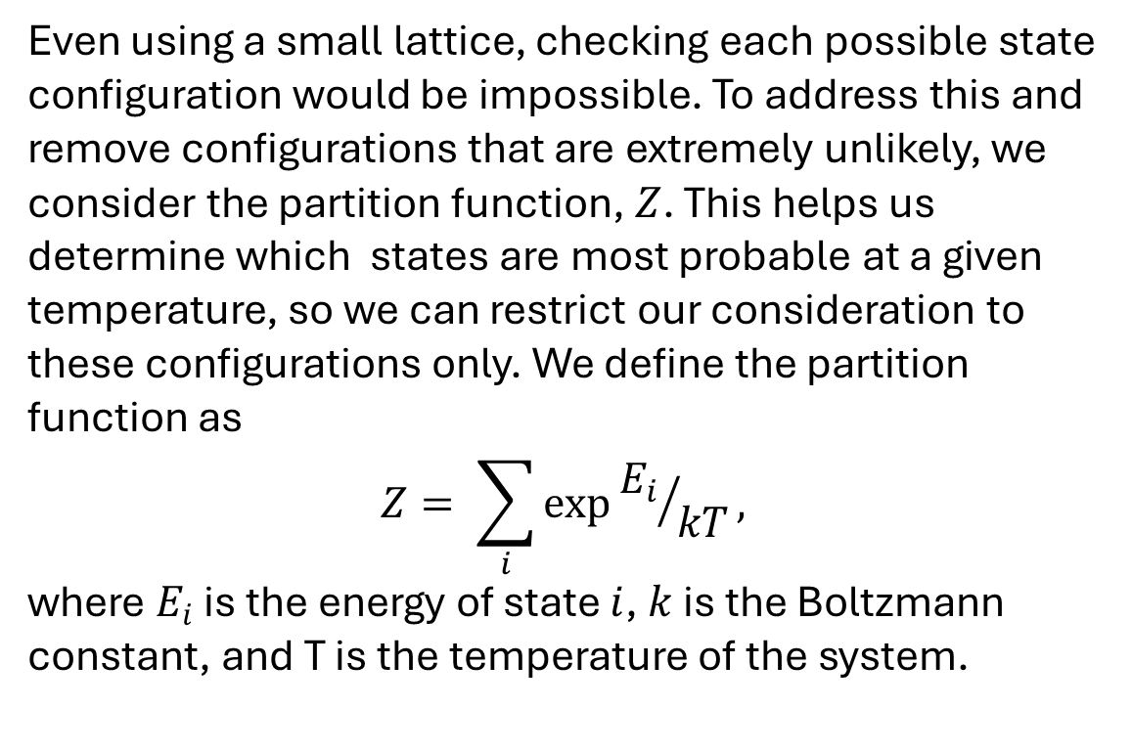
Modelling ferromagnet transitions using the Ising model
1. The Ising Model
J is the interaction strength between neighbouring spins, with J > 0 and J < 0 corresponding with the tendency for neighbouring spins to align or anti-align, respectively.
3) If neither condition is met, retain original spin
We then repeat these steps for every lattice point, applying periodic boundary conditions where necessary. This entire process is an implementation of the well-known metropolis algorithm [3].
The Ising model is a simple model used to describe ferromagnetism using statistical mechanics [1]. For the 2D case, we create a periodic lattice of dimensions $N_{x}$ by $N_{y}$, where each point is randomly assigned a spin value of either +1 (red) or -1 (blue), representing spin-up and spin-down states respectively (see fig.1 for a visual).
The Ising model tells us the total energy of the lattice comes from two sources: the interaction between the spins and an external magnetic field $B$, and the interaction between neighbouring spins[1,2]. For simplicity, the 2D Ising model only considers interactions between the four nearest neighbours, highlighted in white in Fig 1.
Mathematically this energy $E$, can be written as:
$$E=−B\sum_{α}{S_{α}} −J\sum_{<αβ>}{S_{α}S_{β}},$$
where $α$ is the summation over each lattice point (i.e. over all $i$ and $j$), and$β$is the summation of the four nearest neighbours: $\left(i−1,j\right)$, $\left(i+1,j\right), (i ,j−1)$and $\left(i, j+1\right)$[2].
2. Partition function
Even using a small lattice, checking each possible state configuration would be impossible. To address this and remove configurations that are extremely unlikely, we consider the partition function, $Z$. This helps us determine which states are most probable at a given temperature, so we can restrict our consideration to these configurations only. We define the partition function as
$$Z= \sum_{i}{exp⁡{E_{i}}/{kT}},$$
where $E_{i}$ is the energy of state $i$, $k$ is the Boltzmann constant, and T is the temperature of the system.
4. Results
Fig. 2 shows the average magnetisation as a function of sweeps (one sweep corresponds to applying the metropolis algorithm across the entire lattice), for B = -0.05 and J = 0.5. This plot clearly demonstrates the Ising model’s ability to predict the evolution of a ferromagnetic system towards a steady state.
Fig. 1: Periodic lattice (i.e. edges wrap around) with randomly assigned spins. Red = spin-up, Blue = spin-down .
The four nearest neighbours of the centre square are shown using white borders and numbers.
(2)
3. Metropolis algorithm
By flipping the spin of one lattice site and calculating the change in energy, we can use the partition function to see how likely this change is to occur. Since flipping a spin only effects the 4 nearest neighbours, we find the change in energy to be given by:
$$ΔE=−2\left[Jf+B\right]S_{α},$$
where f is the sum of the flipped site’s 4 nearest neighbours, and the negative sign ensures fully aligned spins correlate to a lower energy state. Whether or not we keep the flipped state depends on whether it meets the following criteria:
If $\exp\left({ΔE}/{kT}\right)>1$keep the flipped spin
If not, generate a random number, $n$, between 0 and 1. If $\exp\left({ΔE}/{kT}\right)>n$, keep the flipped spin
(3)
Fig. 2: Plot of average magnetisation per spin against number of sweeps of the Monte Carlo algorithm. These are the results of a 32 x 32 lattice, with B = -0.05, J = 0.5, and kT = 1. Average magnetisation was calculated using
$$<m> =\frac{1}{N_{x}N_{y}}\sum_{α}{S_{α}}$$
(1)
(4)
External Field Contribution
Spin Interaction Contribution
6. References & AI statement
Ising, E. Beitrag zur Theorie des Ferromagnetismus. Z. Physik 31, 253–258 (1925). https://doi.org/10.1007/BF02980577
Onsager, L. Crystal Statistics. I. A Two-Dimensional Model with an Order-Disorder Transition. Phys. Rev. 65, 117–149 (1944). https://doi.org/10.1103/PhysRev.65.117
Metropolis, N., Rosenbluth, A., Rosenbluth, M., Teller, A., and Teller, E. (1953). Equations of state calculations by fast computing machines. J. Chem. Phys., 21(6): 10871092.
Generative AI in the form of ChatGPT was occasionally used to improve clarity of writing only.

Slide 2
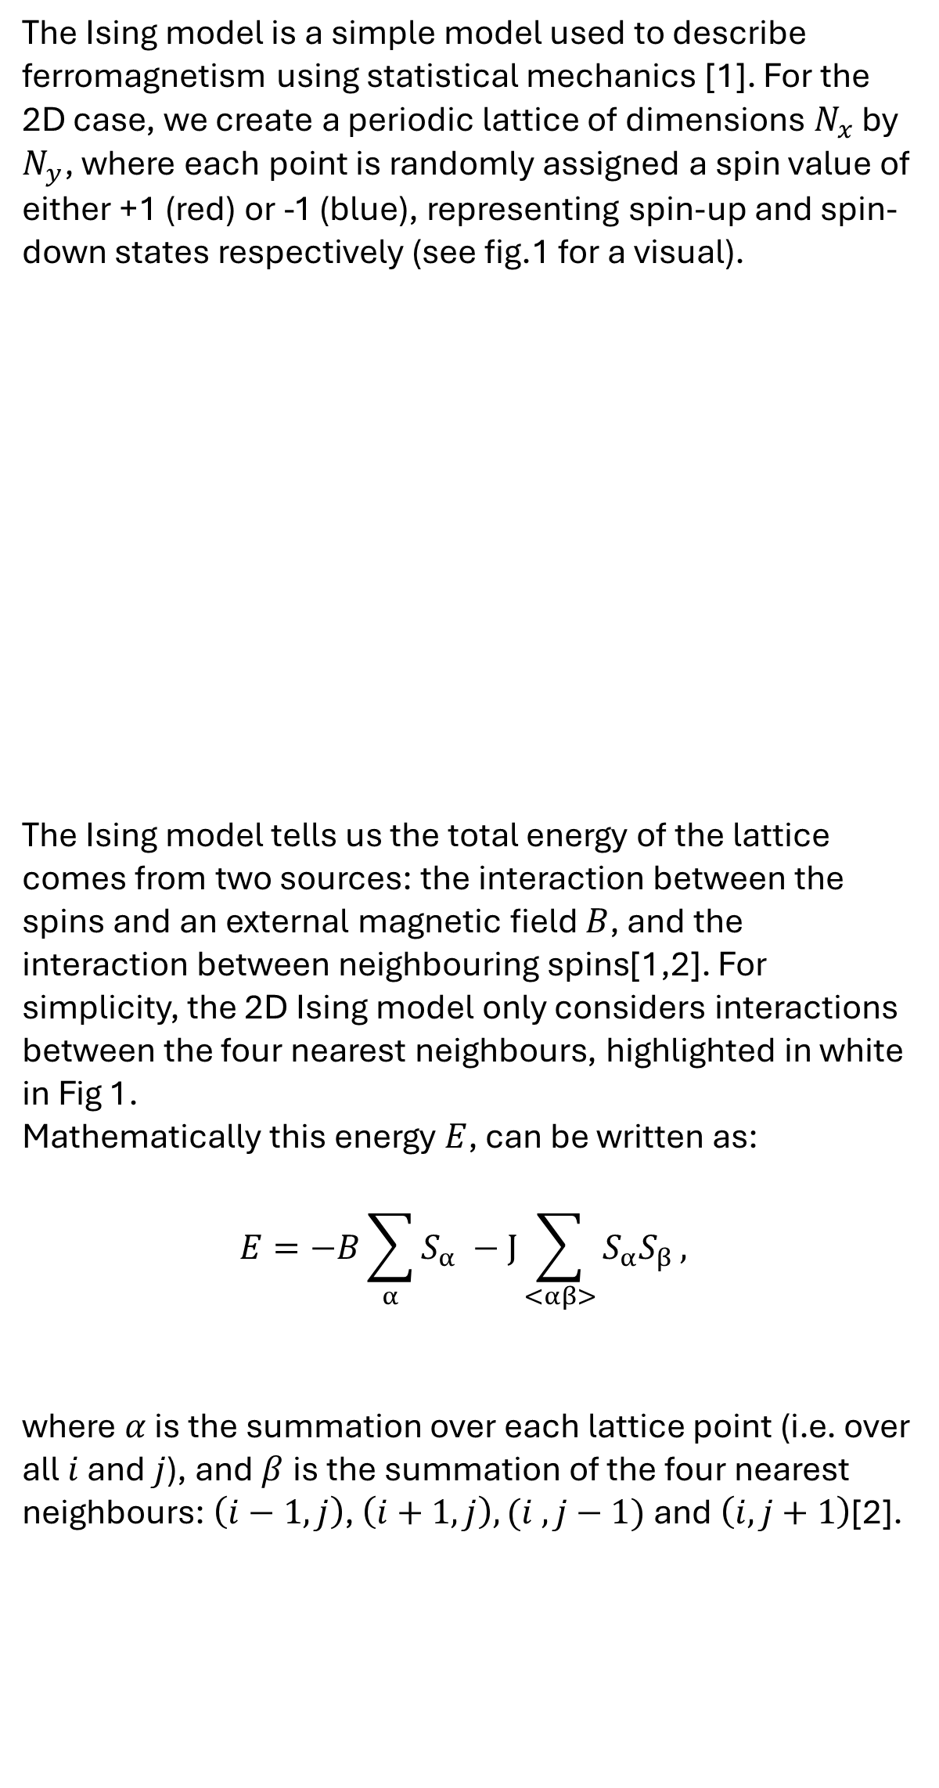
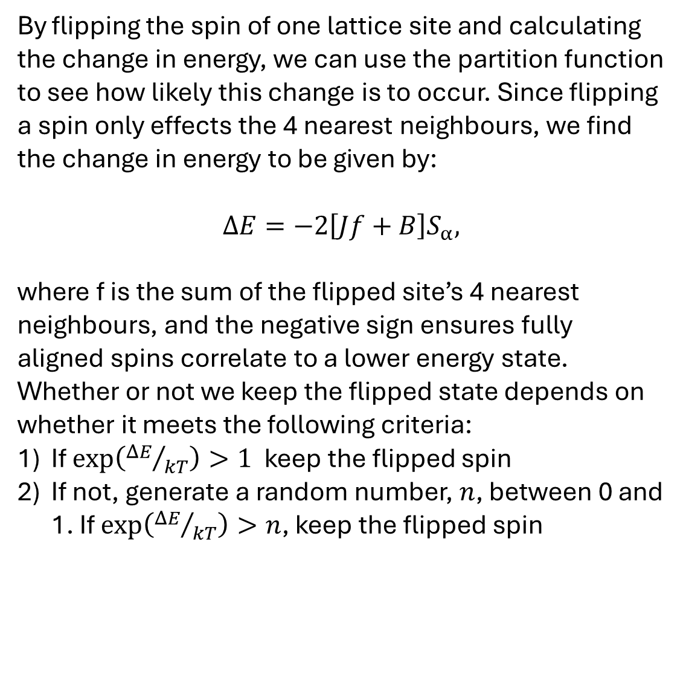
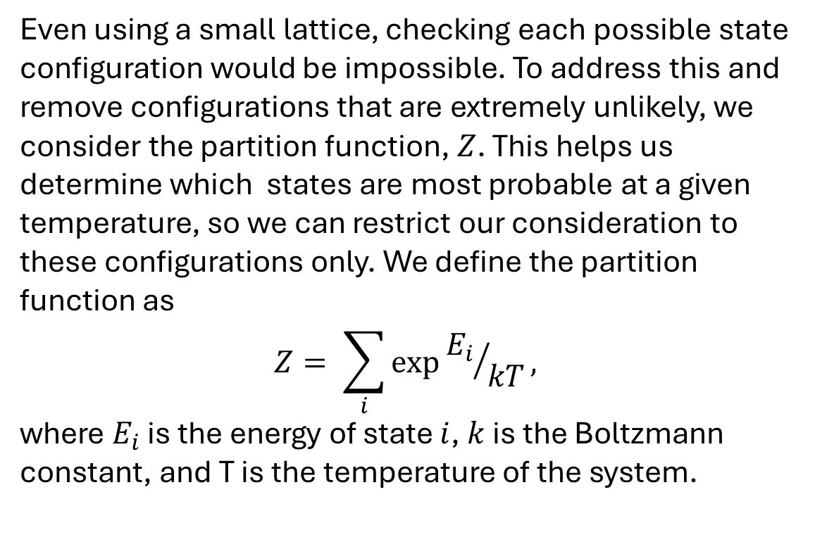
Modelling ferromagnet transitions using the Ising model
1. The Ising Model
J is the interaction strength between neighbouring spins, with J > 0 and J < 0 corresponding with the tendency for neighbouring spins to align or anti-align, respectively.
3) If neither condition is met, retain original spin
We then repeat these steps for every lattice point, applying periodic boundary conditions where necessary. This entire process is an implementation of the well-known metropolis algorithm [3].
The Ising model is a simple model used to describe ferromagnetism using statistical mechanics [1]. For the 2D case, we create a periodic lattice of dimensions $N_{x}$ by $N_{y}$, where each point is randomly assigned a spin value of either +1 (red) or -1 (blue), representing spin-up and spin-down states respectively (see fig.1 for a visual).
The Ising model tells us the total energy of the lattice comes from two sources: the interaction between the spins and an external magnetic field $B$, and the interaction between neighbouring spins[1,2]. For simplicity, the 2D Ising model only considers interactions between the four nearest neighbours, highlighted in white in Fig 1.
Mathematically this energy $E$, can be written as:
$$E=−B\sum_{α}{S_{α}} −J\sum_{<αβ>}{S_{α}S_{β}},$$
where $α$ is the summation over each lattice point (i.e. over all $i$ and $j$), and$β$is the summation of the four nearest neighbours: $\left(i−1,j\right)$, $\left(i+1,j\right), (i ,j−1)$and $\left(i, j+1\right)$[2].
2. Partition function
Even using a small lattice, checking each possible state configuration would be impossible. To address this and remove configurations that are extremely unlikely, we consider the partition function, $Z$. This helps us determine which states are most probable at a given temperature, so we can restrict our consideration to these configurations only. We define the partition function as
$$Z= \sum_{i}{exp⁡{E_{i}}/{kT}},$$
where $E_{i}$ is the energy of state $i$, $k$ is the Boltzmann constant, and T is the temperature of the system.
4. Results
Fig. 2 shows the average magnetisation as a function of sweeps (one sweep corresponds to applying the metropolis algorithm across the entire lattice), for B = -0.05 and J = 0.5. This plot clearly demonstrates the Ising model’s ability to predict the evolution of a ferromagnetic system towards a steady state.
Despite being no exact solution for these parameters (unlike onsagers solution for B = 0), we can use MFT to get an approximate result to compare to. For these parameters MFT gives <M> = 0.96, which is slightly larger than our value, although expected due to its (use sources here).
Fig. 1: Periodic lattice (i.e. edges wrap around) with randomly assigned spins. Red = spin-up, Blue = spin-down .
The four nearest neighbours of the centre square are shown using white borders and numbers.
(2)
3. Metropolis algorithm
By flipping the spin of one lattice site and calculating the change in energy, we can use the partition function to see how likely this change is to occur. Since flipping a spin only effects the 4 nearest neighbours, we find the change in energy to be given by:
$$ΔE=−2\left[Jf+B\right]S_{α},$$
where f is the sum of the flipped site’s 4 nearest neighbours, and the negative sign ensures fully aligned spins correlate to a lower energy state. Whether or not we keep the flipped state depends on whether it meets the following criteria:
If $\exp\left({ΔE}/{kT}\right)>1$keep the flipped spin
If not, generate a random number, $n$, between 0 and 1. If $\exp\left({ΔE}/{kT}\right)>n$, keep the flipped spin
(3)
Fig. 2: Plot of average magnetisation per spin against number of sweeps of the Monte Carlo algorithm. These are the results of a 32 x 32 lattice, with B = -0.05, J = 0.5, and kT = 1. Average magnetisation was calculated using
$$<m> =\frac{1}{N_{x}N_{y}}\sum_{α}{S_{α}}$$
(1)
(4)
External Field Contribution
Spin Interaction Contribution
6. References & AI statement
Ising, E. Beitrag zur Theorie des Ferromagnetismus. Z. Physik 31, 253–258 (1925). https://doi.org/10.1007/BF02980577
Onsager, L. Crystal Statistics. I. A Two-Dimensional Model with an Order-Disorder Transition. Phys. Rev. 65, 117–149 (1944). https://doi.org/10.1103/PhysRev.65.117
Metropolis, N., Rosenbluth, A., Rosenbluth, M., Teller, A., and Teller, E. (1953). Equations of state calculations by fast computing machines. J. Chem. Phys., 21(6): 10871092.
Generative AI in the form of ChatGPT was occasionally used to improve clarity of writing only.

Slide 3
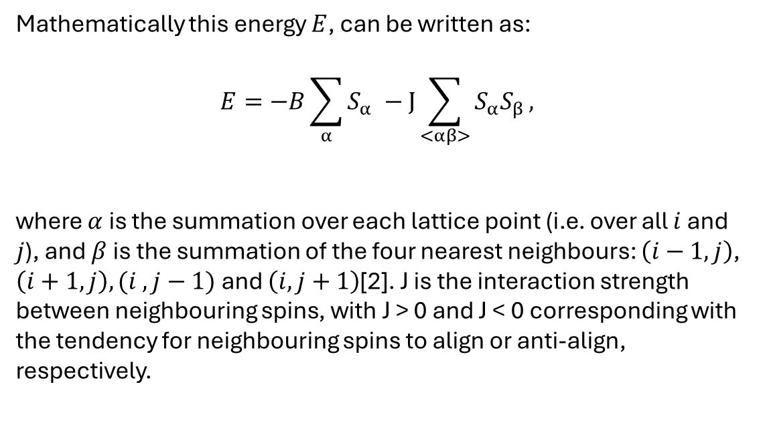
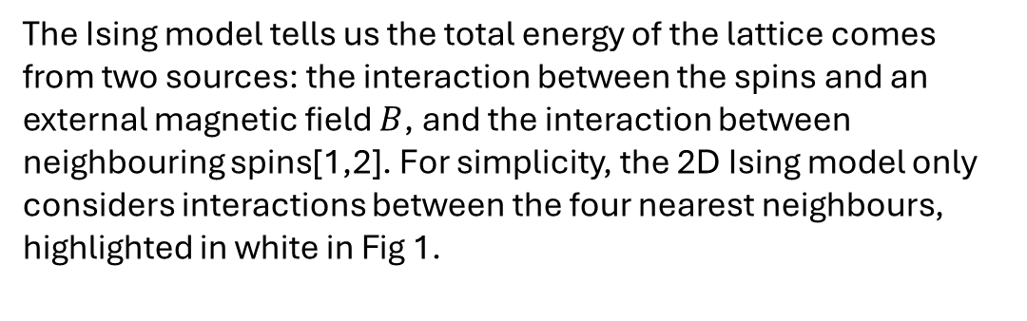

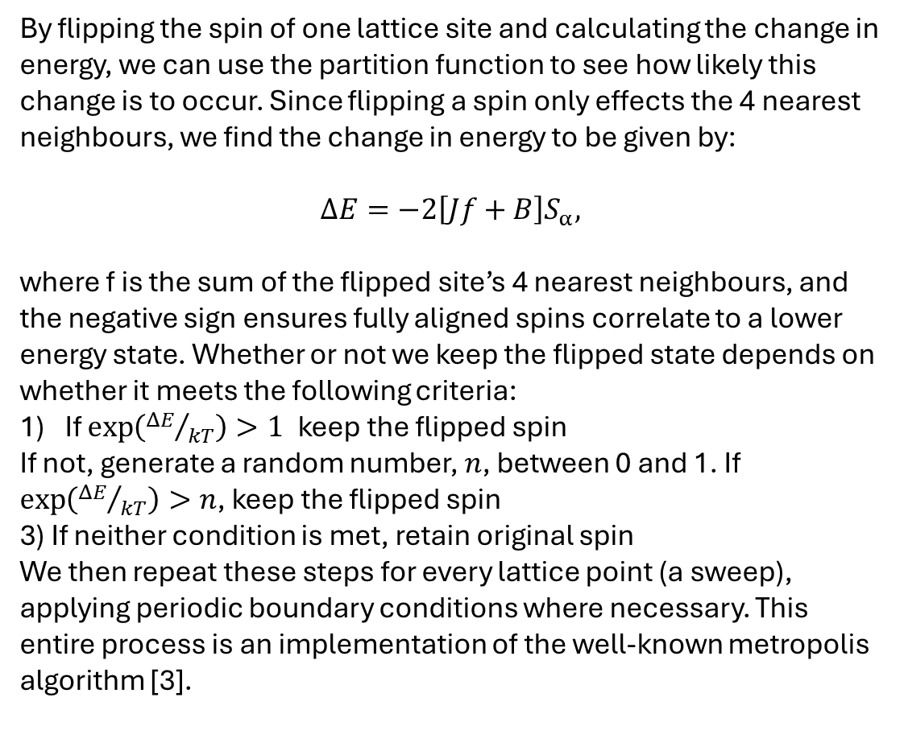
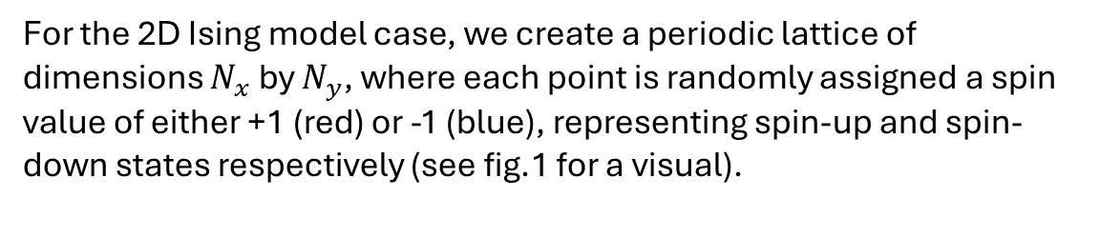
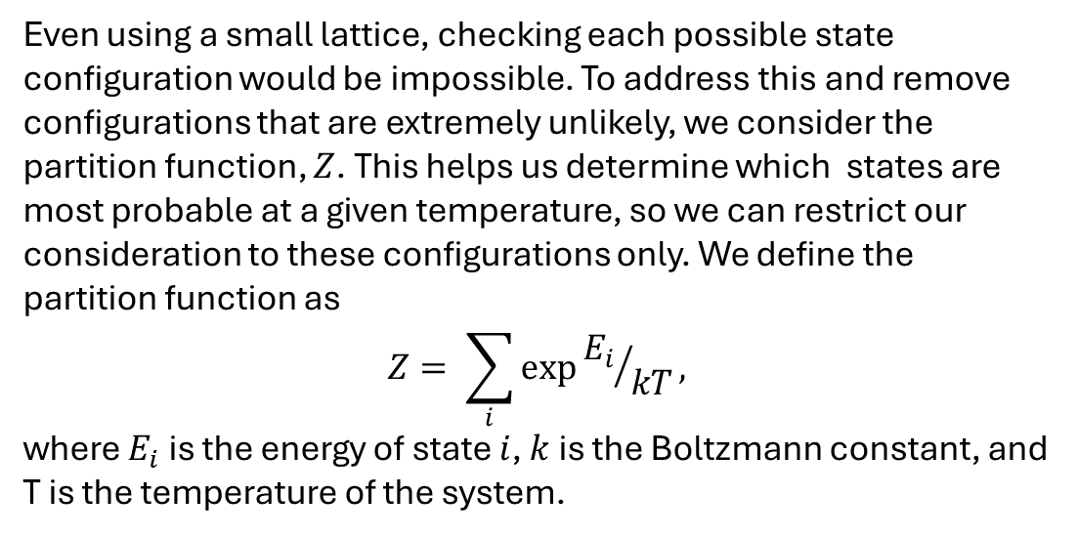
Modelling ferromagnet transitions using the Ising model
Summary
Mathematically this energy $E$, can be written as:
$$E=−B\sum_{α}{S_{α}} −J\sum_{<αβ>}{S_{α}S_{β}},$$
where $α$ is the summation over each lattice point (i.e. over all $i$ and $j$), and$β$is the summation of the four nearest neighbours: $\left(i−1,j\right)$, $\left(i+1,j\right), (i ,j−1)$and $\left(i, j+1\right)$[2]. J is the interaction strength between neighbouring spins, with J > 0 and J < 0 corresponding with the tendency for neighbouring spins to align or anti-align, respectively.
4. Results
Ferromagnetic phase transitions can be modelled using a simple 2D Ising model. Using this model, and Monte-Carlo methods, specifically by the metropolis algorithm, we determine the average mangetisation in the steady state region and compare to literature values.
Fig. 2 shows the average magnetisation as a function of sweeps, for a 32x32 lattice with B = -0.05 and J = 0.5. We define the steady state region as the point where the running average magnetisation doesn’t fluctuate by more than 5% of the difference between the initial and final value. Using this classification, we obtain the average magnetisation of the steady state region to be: $<m> =0.9…±0.00…$, where the error is the standard error in this region.
Despite being no exact solution for these parameters (unlike onsagers solution for B = 0), we can use MFT to get an approximate result to compare to. MFT tells us that $<M_{MFT}≻=\tanh\left[β\left(zJM+B\right)\right]$, For these parameters we get <M> = 0.96, which is slightly larger than our value, although expected since MFT ignores fluctuations, and hence overesitmates spins tendency to order. [sOURCE]. Another value we can compare to is from an ansatza approach, by Moorad Alexanian, where a value of $<M_{ansatz}> =$ is obtained. Although the latter is a relatively new and unexplored approach, our value clearly seems to be in agreement with both models, and the expectation that spins will align with the external field [source]
A short visualisation on how the grid changes with sweeps can be seen here as well:
Spin Interaction Contribution
External Field Contribution
Introduction
Since being discovered in (….) magnetism has been of interest to humans due to its various uses throughout the centuries, from being used as compasses to enhance exploration, to more recent times using it as data storage in the form of hard drives. There have been multiple theories that can successfully describe ferromagnetism, notably MFT theory and the Heisenberg model, but none as simple to model and easy to solve as the Ising model, all whilst still having significant ability to model essential physics & even non-physics (stock markets, social sciences etc..). For this reason, in this project we focus on the Ising model due its simplicity to code, and run simulations.
2. Partition function
Even using a small lattice, checking each possible state configuration would be impossible. To address this and remove configurations that are extremely unlikely, we consider the partition function, $Z$. This helps us determine which states are most probable at a given temperature, so we can restrict our consideration to these configurations only. We define the partition function as
$$Z= \sum_{i}{exp⁡{E_{i}}/{kT}},$$
where $E_{i}$ is the energy of state $i$, $k$ is the Boltzmann constant, and T is the temperature of the system.
1. The Ising Model
For the 2D Ising model case, we create a periodic lattice of dimensions $N_{x}$ by $N_{y}$, where each point is randomly assigned a spin value of either +1 (red) or -1 (blue), representing spin-up and spin-down states respectively (see fig.1 for a visual).
3. Metropolis algorithm
Fig. 1: Periodic lattice (i.e. edges wrap around) with randomly assigned spins. Red = spin-up, Blue = spin-down .
The four nearest neighbours of the centre square are shown using white borders and numbers.
By flipping the spin of one lattice site and calculating the change in energy, we can use the partition function to see how likely this change is to occur. Since flipping a spin only effects the 4 nearest neighbours, we find the change in energy to be given by:
$$ΔE=−2\left[Jf+B\right]S_{α},$$
where f is the sum of the flipped site’s 4 nearest neighbours, and the negative sign ensures fully aligned spins correlate to a lower energy state. Whether or not we keep the flipped state depends on whether it meets the following criteria:
If $\exp\left({ΔE}/{kT}\right)>1$keep the flipped spin
If not, generate a random number, $n$, between 0 and 1. If $\exp\left({ΔE}/{kT}\right)>n$, keep the flipped spin
3) If neither condition is met, retain original spin
We then repeat these steps for every lattice point (a sweep), applying periodic boundary conditions where necessary. This entire process is an implementation of the well-known metropolis algorithm [3].
Fig. 2: Plot of average magnetisation per spin against number of sweeps of the Monte Carlo algorithm. These are the results of a 32 x 32 lattice, with B = -0.05, J = 0.5, and kT = 1. Average magnetisation was calculated using
$$<m> =\frac{1}{N_{x}N_{y}}\sum_{α}{S_{α}}$$
The Ising model tells us the total energy of the lattice comes from two sources: the interaction between the spins and an external magnetic field $B$, and the interaction between neighbouring spins[1,2]. For simplicity, the 2D Ising model only considers interactions between the four nearest neighbours, highlighted in white in Fig 1.
(4)
6. References & AI statement
Ising, E. Beitrag zur Theorie des Ferromagnetismus. Z. Physik 31, 253–258 (1925). https://doi.org/10.1007/BF02980577
Onsager, L. Crystal Statistics. I. A Two-Dimensional Model with an Order-Disorder Transition. Phys. Rev. 65, 117–149 (1944). https://doi.org/10.1103/PhysRev.65.117
Metropolis, N., Rosenbluth, A., Rosenbluth, M., Teller, A., and Teller, E. (1953). Equations of state calculations by fast computing machines. J. Chem. Phys., 21(6): 10871092.
Generative AI in the form of ChatGPT was occasionally used to improve clarity of writing only.

Slide 4
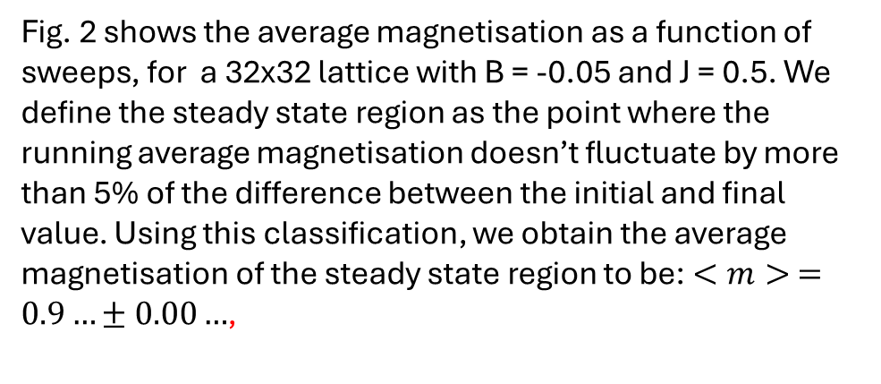
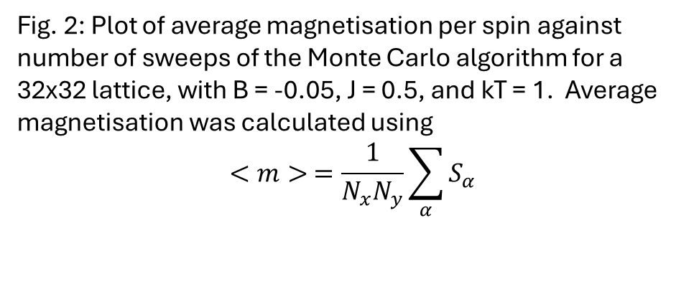
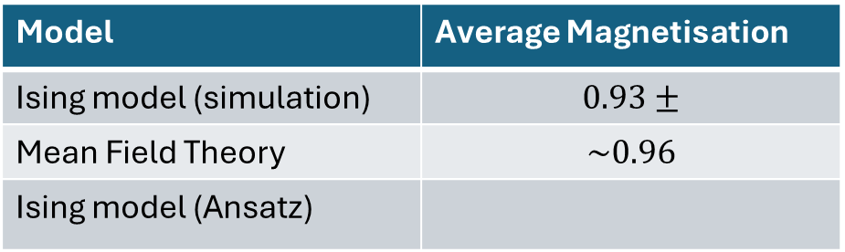
Modelling a ferromagnet using the Ising moadel
Summary
Mathematically this energy $E$, can be written as:
$$E=−B\sum_{α}{S_{α}} −J\sum_{<αβ>}{S_{α}S_{β}},$$
where $α$ is the summation over each lattice point (i.e. over all $i$ and $j$), and$β$is the summation of the four nearest neighbours: $\left(i−1,j\right)$, $\left(i+1,j\right), (i ,j−1)$and $\left(i, j+1\right)$[2]. J is the interaction strength between neighbouring spins, with J > 0 and J < 0 corresponding with the tendency for neighbouring spins to align or anti-align, respectively.
4. Results
Ferromagnets can be modelled using a simple 2D Ising model. Using this model, and Monte-Carlo methods (specifically the metropolis algorithm), we determine the average magnetisation in the steady state region and compare to literature values.
Fig. 2 shows the average magnetisation as a function of sweeps, for a 32x32 lattice with B = -0.05 and J = 0.5. We define the steady state region as the point where the running average magnetisation doesn’t fluctuate by more than 5% of the difference between the initial and final value. Using this classification, we obtain the average magnetisation of the steady state region to be: $<m> =0.9…±0.00…$,
Spin Interaction Contribution
External Field Contribution
Introduction
Magnetism has been of interest to humans for centuries, being used as compasses to enhance exploration, to modern data storage as magnetic hard drives. Many theories can successfully describe ferromagnetism, notably Mean Field Theory (MFT) and the Heisenberg model, but none as simple to model and solve as the Ising model. Despite its simplicity, it still captures essential physics, like phase transitions and the critical temperatures & is even widely used outside of physics, e.g to model financial markets.
In this project, we use the Ising model due to its computational simplicity, and ability to reproduce key magnetic behaviour.
Model | Average Magnetisation
Ising model (simulation) | $$0.93±$$
Mean Field Theory | $$\sim 0.96$$
Ising model (Ansatz)
2. Partition function
Even using a small lattice, checking each possible state configuration would be impossible. To address this and remove configurations that are extremely unlikely, we consider the partition function, $Z$. This helps us determine which states are most probable at a given temperature, so we can restrict our consideration to these configurations only. We define the partition function as
$$Z= \sum_{i}{exp⁡{E_{i}}/{kT}},$$
where $E_{i}$ is the energy of state $i$, $k$ is the Boltzmann constant, and T is the temperature of the system.
1. The Ising Model
For the 2D Ising model case, we create a periodic lattice of dimensions $N_{x}$ by $N_{y}$, where each point is randomly assigned a spin value of either +1 (red) or -1 (blue), representing spin-up and spin-down states respectively (see fig.1 for a visual).
3. Metropolis algorithm
Fig. 1: Periodic lattice (i.e. edges wrap around) with randomly assigned spins. Red = spin-up, Blue = spin-down .
The four nearest neighbours of the centre square are shown using white borders and numbers.
By flipping the spin of one lattice site and calculating the change in energy, we can use the partition function to see how likely this change is to occur. Since flipping a spin only effects the 4 nearest neighbours, we find the change in energy to be given by:
$$ΔE=−2\left[Jf+B\right]S_{α},$$
where f is the sum of the flipped site’s 4 nearest neighbours, and the negative sign ensures fully aligned spins correlate to a lower energy state. Whether or not we keep the flipped state depends on whether it meets the following criteria:
If $\exp\left({ΔE}/{kT}\right)>1$keep the flipped spin
If not, generate a random number, $n$, between 0 and 1. If $\exp\left({ΔE}/{kT}\right)>n$, keep the flipped spin
3) If neither condition is met, retain original spin
We then repeat these steps for every lattice point (a sweep), applying periodic boundary conditions where necessary. This entire process is an implementation of the well-known metropolis algorithm [3].
Fig. 2: Plot of average magnetisation per spin against number of sweeps of the Monte Carlo algorithm for a 32x32 lattice, with B = -0.05, J = 0.5, and kT = 1. Average magnetisation was calculated using
$$<m> =\frac{1}{N_{x}N_{y}}\sum_{α}{S_{α}}$$
The Ising model tells us the total energy of the lattice comes from two sources: the interaction between the spins and an external magnetic field $B$, and the interaction between neighbouring spins[1,2]. For simplicity, the 2D Ising model only considers interactions between the four nearest neighbours, highlighted in white in Fig 1.
(4)
6. References & AI statement
Ising, E. Beitrag zur Theorie des Ferromagnetismus. Z. Physik 31, 253–258 (1925). https://doi.org/10.1007/BF02980577
Onsager, L. Crystal Statistics. I. A Two-Dimensional Model with an Order-Disorder Transition. Phys. Rev. 65, 117–149 (1944). https://doi.org/10.1103/PhysRev.65.117
Metropolis, N., Rosenbluth, A., Rosenbluth, M., Teller, A., and Teller, E. (1953). Equations of state calculations by fast computing machines. J. Chem. Phys., 21(6): 10871092.
Generative AI in the form of ChatGPT was occasionally used to improve clarity of writing only.

Slide 5
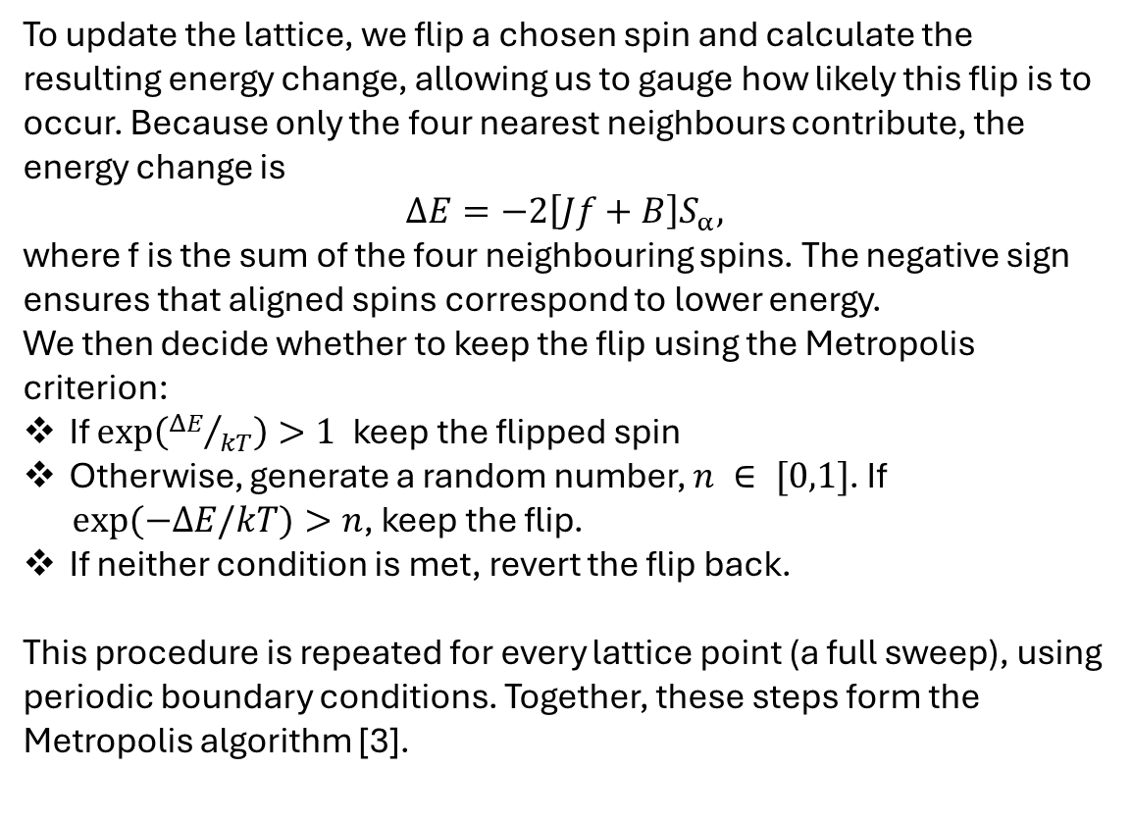
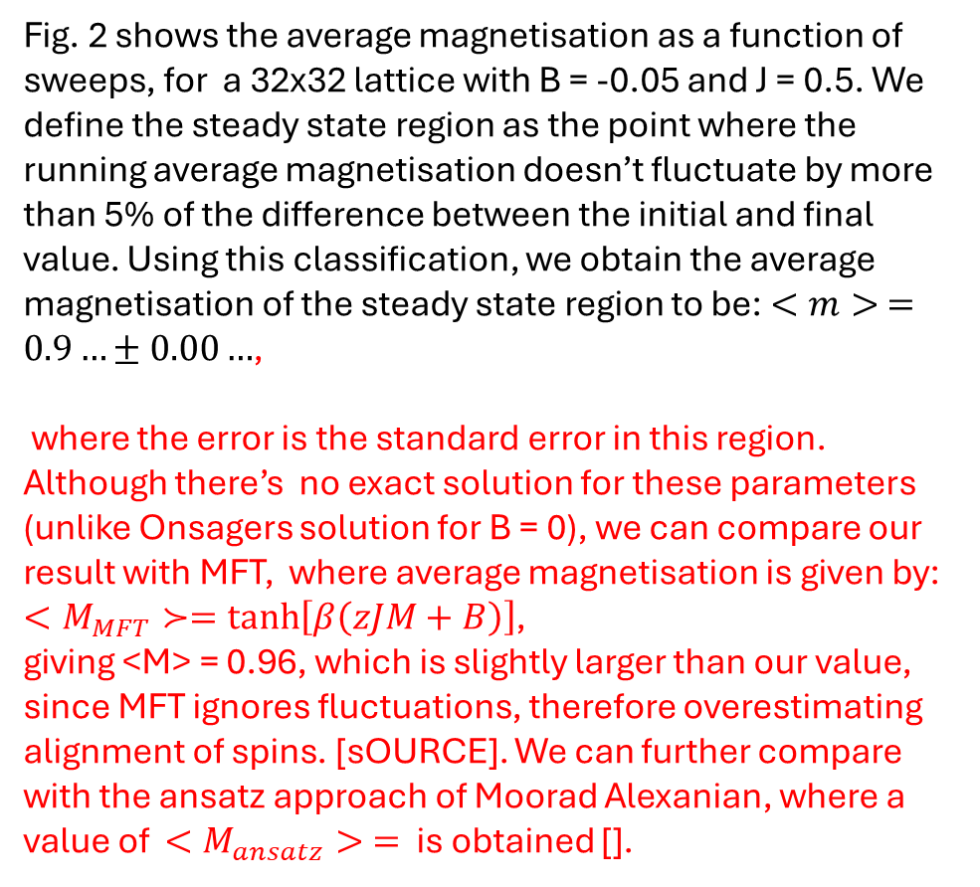
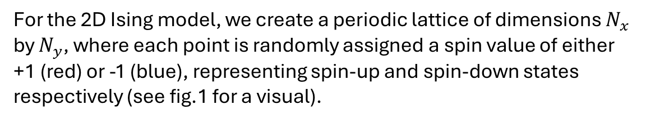
Modelling a ferromagnet using the Ising model
Summary
Mathematically this energy $E$, can be written as:
$$E=−B\sum_{α}{S_{α}} −J\sum_{<αβ>}{S_{α}S_{β}},$$
where $α$ is the summation over each lattice point (i.e. over all $i$ and $j$), and$β$is the summation of the four nearest neighbours: $\left(i−1,j\right)$, $\left(i+1,j\right), (i ,j−1)$and $\left(i, j+1\right)$[2]. J is the interaction strength between neighbouring spins, with J > 0 and J < 0 corresponding with the tendency for neighbouring spins to align or anti-align, respectively.
4. Results
Ferromagnets can be modelled using a simple 2D Ising model. Using this model, and Monte-Carlo methods (specifically the metropolis algorithm), we determine the average magnetisation in the steady state region and compare to literature values.
Fig. 2 shows the average magnetisation as a function of sweeps, for a 32x32 lattice with B = -0.05 and J = 0.5. We define the steady state region as the point where the running average magnetisation doesn’t fluctuate by more than 5% of the difference between the initial and final value. Using this classification, we obtain the average magnetisation of the steady state region to be: $<m> =0.9…±0.00…$,
where the error is the standard error in this region. Although there’s no exact solution for these parameters (unlike Onsagers solution for B = 0), we can compare our result with MFT, where average magnetisation is given by: $<M_{MFT}≻=\tanh\left[β\left(zJM+B\right)\right]$,
giving <M> = 0.96, which is slightly larger than our value, since MFT ignores fluctuations, therefore overestimating alignment of spins. [sOURCE]. We can further compare with the ansatz approach of Moorad Alexanian, where a value of $<M_{ansatz}> =$ is obtained [].
Spin Interaction Contribution
External Field Contribution
Introduction
Magnetism has long been central to technology, from early compasses to modern data storage. Many models successfully described ferromagnetism, such as Mean Field Theory (MFT) and the Heisenberg model, but the Ising model stands out for its simplicity and analytical tractability. Despite being simple, it captures key phenomena, such as phase transitions and critical temperatures, and is widely used even outside of physics e.g. to model financial markets. In this project, the Ising model is used for its computational simplicity and ability to reproduce essential magnetic behaviour.
2. Partition function
Even using a small lattice, checking each possible state configuration would be impossible. To address this and remove configurations that are extremely unlikely, we consider the partition function, $Z$. This helps us determine which states are most probable at a given temperature, so we can restrict our consideration to these configurations only. We define the partition function as
$$Z= \sum_{i}{exp⁡{E_{i}}/{kT}},$$
where $E_{i}$ is the energy of state $i$, $k$ is the Boltzmann constant, and T is the temperature of the system.
 |  | 1
 | 4 |  | 2
 |  | 3
1. The Ising Model
For the 2D Ising model, we create a periodic lattice of dimensions $N_{x}$ by $N_{y}$, where each point is randomly assigned a spin value of either +1 (red) or -1 (blue), representing spin-up and spin-down states respectively (see fig.1 for a visual).
3. Metropolis algorithm
 |  | 1
 | 4 |  | 2
 |  | 3
Fig. 1: Periodic lattice (i.e. edges wrap around) with randomly assigned spins. Red = spin-up, Blue = spin-down .
The four nearest neighbours of the centre square are shown using white borders and numbers.
To update the lattice, we flip a chosen spin and calculate the resulting energy change, allowing us to gauge how likely this flip is to occur. Because only the four nearest neighbours contribute, the energy change is
$$ΔE=−2\left[Jf+B\right]S_{α},$$
where f is the sum of the four neighbouring spins. The negative sign ensures that aligned spins correspond to lower energy.
We then decide whether to keep the flip using the Metropolis criterion:
If $\exp\left({ΔE}/{kT}\right)>1$keep the flipped spin
Otherwise, generate a random number, $n ∈ [0,1]$. If
$exp⁡(−ΔE/kT)>n$, keep the flip.
If neither condition is met, revert the flip back.
This procedure is repeated for every lattice point (a full sweep), using periodic boundary conditions. Together, these steps form the Metropolis algorithm [3].
Fig. 2: Plot of average magnetisation per spin against number of sweeps of the Monte Carlo algorithm for a 32x32 lattice, with B = -0.05, J = 0.5, and kT = 1. Average magnetisation was calculated using
$$<m> =\frac{1}{N_{x}N_{y}}\sum_{α}{S_{α}}$$
The Ising model tells us the total energy of the lattice comes from two sources: the interaction between the spins and an external magnetic field $B$, and the interaction between neighbouring spins[1,2]. For simplicity, the 2D Ising model only considers interactions between the four nearest neighbours, highlighted in white in Fig 1.
(4)
6. References & AI statement
Ising, E. Beitrag zur Theorie des Ferromagnetismus. Z. Physik 31, 253–258 (1925). https://doi.org/10.1007/BF02980577
Onsager, L. Crystal Statistics. I. A Two-Dimensional Model with an Order-Disorder Transition. Phys. Rev. 65, 117–149 (1944). https://doi.org/10.1103/PhysRev.65.117
Metropolis, N., Rosenbluth, A., Rosenbluth, M., Teller, A., and Teller, E. (1953). Equations of state calculations by fast computing machines. J. Chem. Phys., 21(6): 10871092.
Generative AI in the form of ChatGPT was occasionally used to improve clarity of writing only.

Slide 6


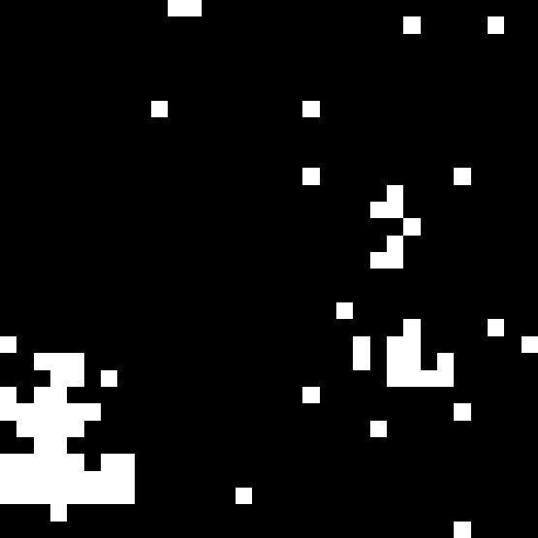
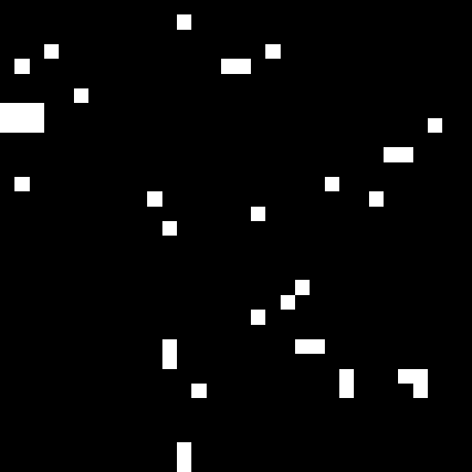

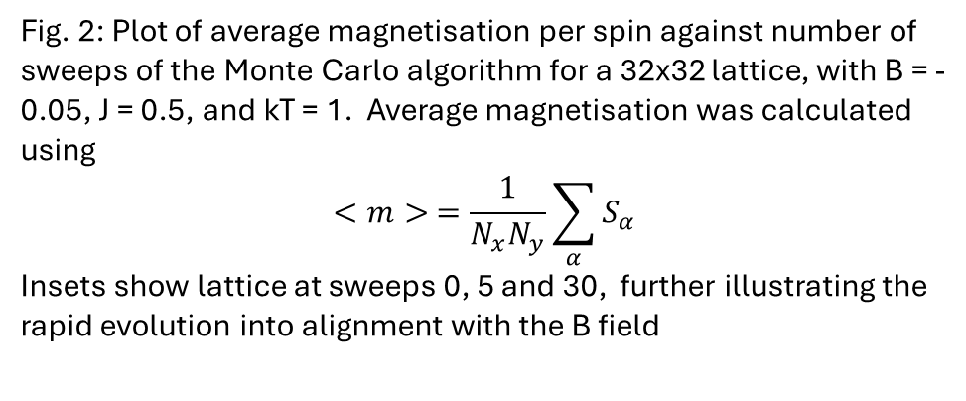
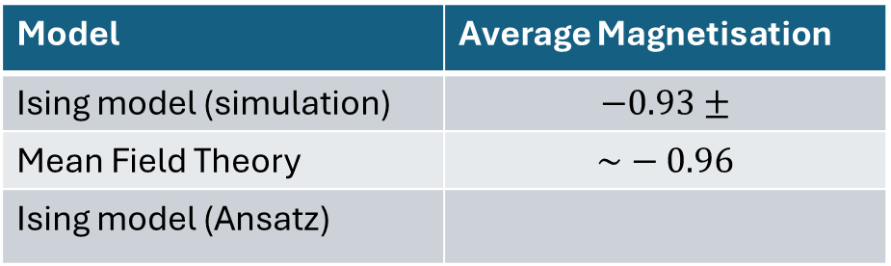
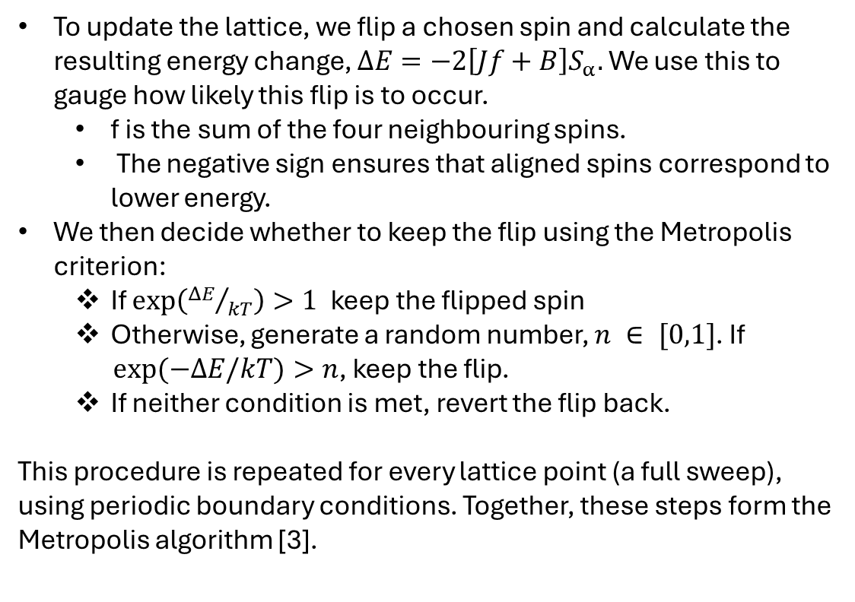
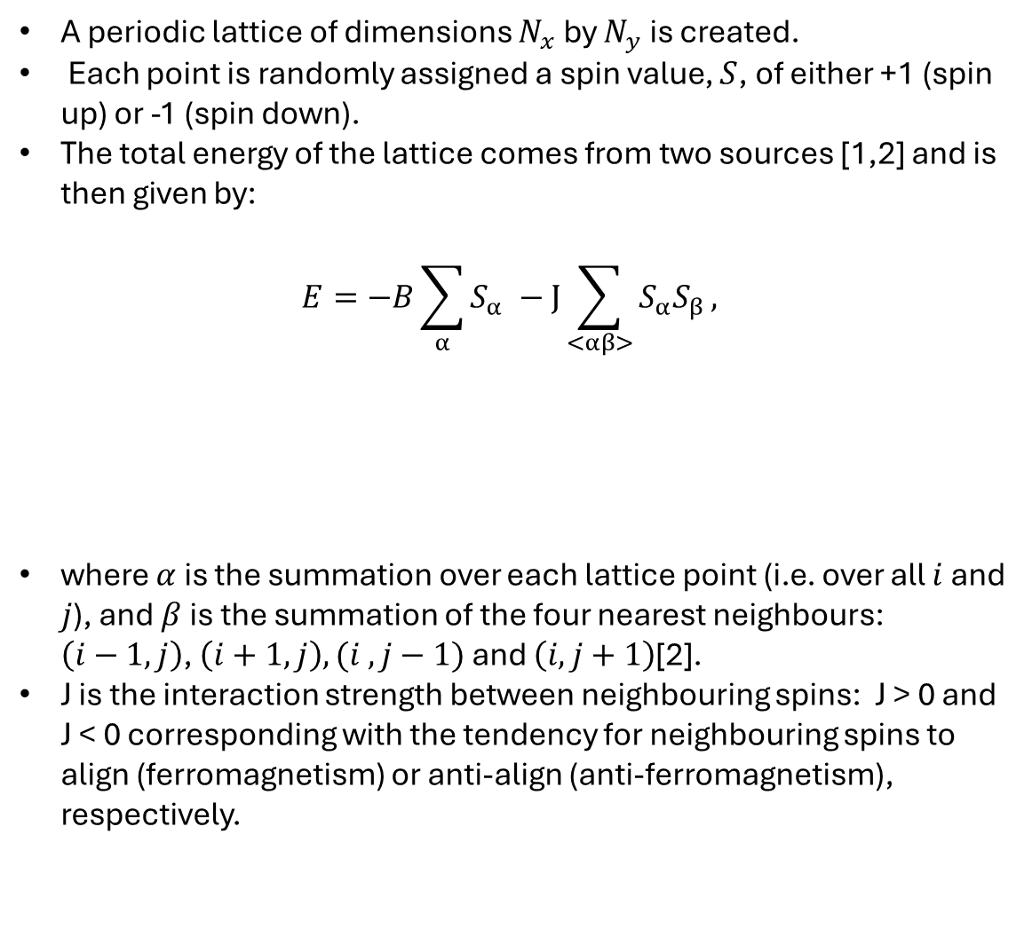
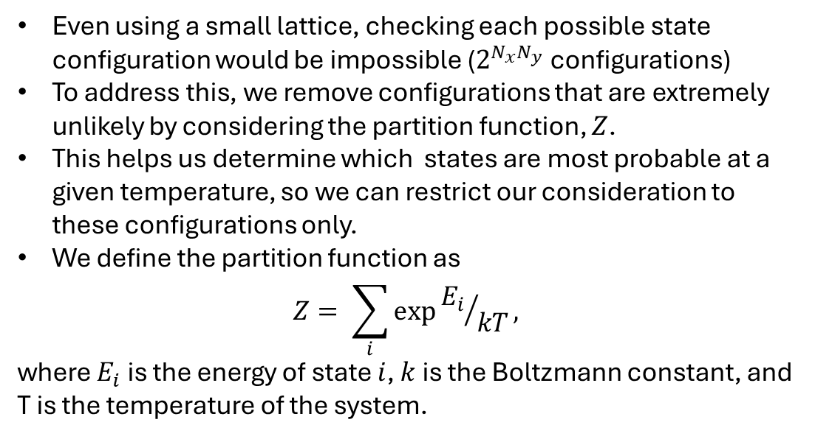
Modelling a ferromagnet using the Ising model
Summary
 |  | 1
 | 4 |  | 2
 |  | 3
Fig. 1: Periodic lattice (i.e. edges wrap around) with randomly assigned spins. White = spin-up, Black = spin-down .
The four nearest neighbours of the centre square are shown using red borders and numbers.
4. Results
Ferromagnets can be modelled using a simple 2D Ising model. Using this model, and Monte-Carlo methods (the metropolis algorithm), we determine the average magnetisation in the steady state region and compare to literature values.
Fig. 2 shows the average magnetisation as a function of sweeps, for a 32x32 lattice with B = -0.05 and J = 0.5.
We define the steady state region as the point where the running average magnetisation doesn’t fluctuate by more than 5% of the difference between the initial and final value.
Average magnetisation predicted by my simulation, Mean Field theory[] and an Ansatz approach []is shown in table 1
Introduction
Magnetism has long been central to technology, from early compasses to modern data storage. Many models successfully described ferromagnetism, such as Mean Field Theory (MFT) and the Heisenberg model, but the Ising model stands out for its simplicity and analytical tractability. Despite being simple, it captures key phenomena, such as phase transitions and critical temperatures, and is widely used even outside of physics e.g. to model financial markets. In this project, the Ising model is used to calculate the average magnetisation (at steady state) of a lattice when placed in an external field
Model | Average Magnetisation
Ising model (simulation) | $$−0.93±$$
Mean Field Theory | $$\sim −0.96$$
Ising model (Ansatz)
2. Partition function
Even using a small lattice, checking each possible state configuration would be impossible ($2^{N_{x}N_{y}}$configurations)
To address this, we remove configurations that are extremely unlikely by considering the partition function, $Z$.
This helps us determine which states are most probable at a given temperature, so we can restrict our consideration to these configurations only.
We define the partition function as
$$Z= \sum_{i}{exp⁡{E_{i}}/{kT}},$$
where $E_{i}$ is the energy of state $i$, $k$ is the Boltzmann constant, and T is the temperature of the system.
Lattice evolution
1. The 2D Ising Model
A periodic lattice of dimensions $N_{x}$ by $N_{y}$ is created.
Each point is randomly assigned a spin value, $S$, of either +1 (spin up) or -1 (spin down).
The total energy of the lattice comes from two sources [1,2] and is then given by:
$$E=−B\sum_{α}{S_{α}} −J\sum_{<αβ>}{S_{α}S_{β}},$$
where $α$ is the summation over each lattice point (i.e. over all $i$ and $j$), and$β$is the summation of the four nearest neighbours: $\left(i−1,j\right)$, $\left(i+1,j\right), (i ,j−1)$and $\left(i, j+1\right)$[2].
J is the interaction strength between neighbouring spins: J > 0 and J < 0 corresponding with the tendency for neighbouring spins to align (ferromagnetism) or anti-align (anti-ferromagnetism), respectively.
0 Sweeps
5 Sweeps
30 Sweeps
3. Metropolis algorithm
To update the lattice, we flip a chosen spin and calculate the resulting energy change, $ΔE=−2\left[Jf+B\right]S_{α}.$ We use this to gauge how likely this flip is to occur.
f is the sum of the four neighbouring spins.
The negative sign ensures that aligned spins correspond to lower energy.
We then decide whether to keep the flip using the Metropolis criterion:
If $\exp\left({ΔE}/{kT}\right)>1$keep the flipped spin
Otherwise, generate a random number, $n ∈ [0,1]$. If
$exp⁡(−ΔE/kT)>n$, keep the flip.
If neither condition is met, revert the flip back.
This procedure is repeated for every lattice point (a full sweep), using periodic boundary conditions. Together, these steps form the Metropolis algorithm [3].
External Field Contribution
Spin Interaction Contribution
Fig. 2: Plot of average magnetisation per spin against number of sweeps of the Monte Carlo algorithm for a 32x32 lattice, with B = -0.05, J = 0.5, and kT = 1. Average magnetisation was calculated using
$$<m> =\frac{1}{N_{x}N_{y}}\sum_{α}{S_{α}}$$
Insets show lattice at sweeps 0, 5 and 30, further illustrating the rapid evolution into alignment with the B field
(4)
6. References & AI statement
Ising, E. Beitrag zur Theorie des Ferromagnetismus. Z. Physik 31, 253–258 (1925). https://doi.org/10.1007/BF02980577
Onsager, L. Crystal Statistics. I. A Two-Dimensional Model with an Order-Disorder Transition. Phys. Rev. 65, 117–149 (1944). https://doi.org/10.1103/PhysRev.65.117
Metropolis, N., Rosenbluth, A., Rosenbluth, M., Teller, A., and Teller, E. (1953). Equations of state calculations by fast computing machines. J. Chem. Phys., 21(6): 10871092.
Generative AI in the form of ChatGPT was occasionally used to improve clarity of writing only.

Slide 7
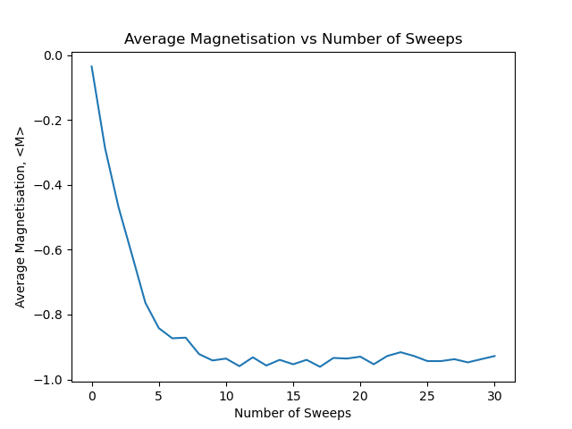
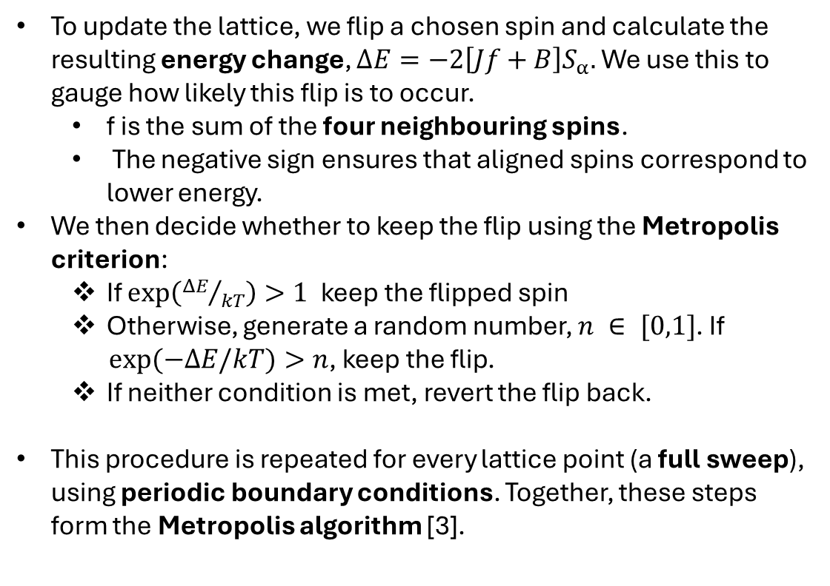
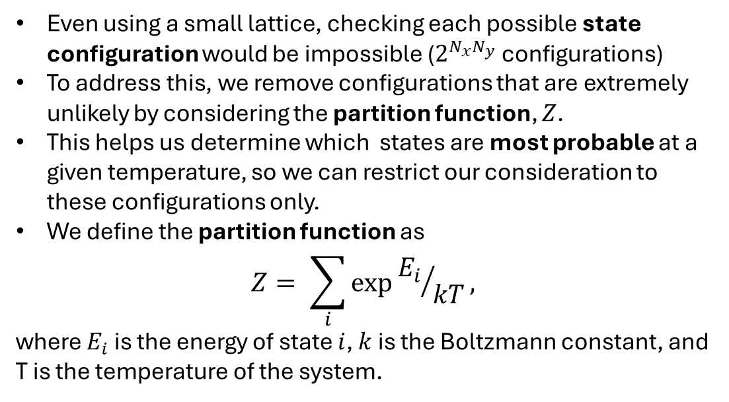
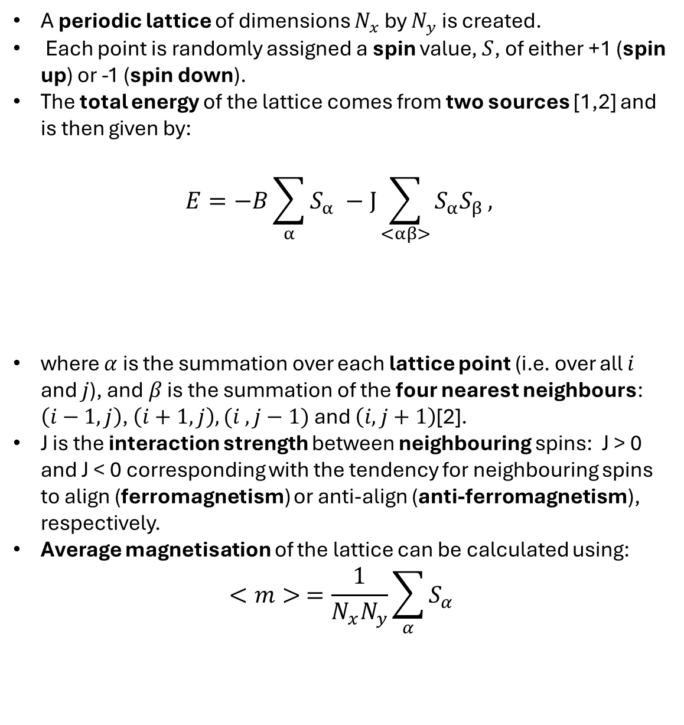
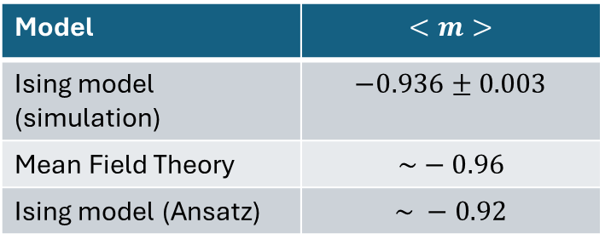
Modelling a ferromagnet using the Ising model
By Charlie Cook
Ferromagnets can be modelled using a simple 2D Ising model. Using this model, and Monte-Carlo methods (the metropolis algorithm), we determine the average magnetisation in the steady state region for a set of specific conditions and compare to other models of ferromagnets, all showing good agreement with one another.
Introduction
 |  | 1
 | 4 |  | 2
 |  | 3
4. Results
Magnetism has long been central to technology, from early compasses to modern data storage.
Many models successfully described ferromagnetism, such as Mean Field Theory (MFT) and the Heisenberg model, but the Ising model stands out for its simplicity and analytical tractability.
Despite being simple, it captures key phenomena, such as phase transitions and critical temperatures, and is widely used even outside of physics e.g. to model financial markets.
In this project, the Ising model is used to calculate the average magnetisation (at steady state) of a lattice when placed in an external field
Fig. 1: Periodic lattice (i.e. edges wrap around) with randomly assigned spins. White = spin-up, Black = spin-down .
The four nearest neighbours of the centre square are shown using red borders and numbers.
Fig. 2 shows the average magnetisation as a function of sweeps, for a 32x32 lattice with B = -0.05 and J = 0.5.
We define the steady state region as the point where the running average magnetisation doesn’t fluctuate by more than 5% of the difference between the initial and final value.
Average magnetisation predicted by my simulation, Mean Field theory [4] and an Ansatz approach [5] is shown in table 1 below in Table 1.
2. Partition Function
Table 1: Average magnetisation predicted by different models. MFT prediction is slightly larger since it ignores thermal fluctuations.
Model | $$<m>$$
Ising model (simulation) | $$−0.936±0.003$$
Mean Field Theory | $$\sim −0.96$$
Ising model (Ansatz) | $$\sim −0.92$$
1. 2D Ising Model
Even using a small lattice, checking each possible state configuration would be impossible ($2^{N_{x}N_{y}}$configurations)
To address this, we remove configurations that are extremely unlikely by considering the partition function, $Z$.
This helps us determine which states are most probable at a given temperature, so we can restrict our consideration to these configurations only.
We define the partition function as
$$Z= \sum_{i}{exp⁡{E_{i}}/{kT}},$$
where $E_{i}$ is the energy of state $i$, $k$ is the Boltzmann constant, and T is the temperature of the system.
A periodic lattice of dimensions $N_{x}$ by $N_{y}$ is created.
Each point is randomly assigned a spin value, $S$, of either +1 (spin up) or -1 (spin down).
The total energy of the lattice comes from two sources [1,2] and is then given by:
$$E=−B\sum_{α}{S_{α}} −J\sum_{<αβ>}{S_{α}S_{β}},$$
where $α$ is the summation over each lattice point (i.e. over all $i$ and $j$), and$β$is the summation of the four nearest neighbours: $\left(i−1,j\right)$, $\left(i+1,j\right), (i ,j−1)$and $\left(i, j+1\right)$[2].
J is the interaction strength between neighbouring spins: J > 0 and J < 0 corresponding with the tendency for neighbouring spins to align (ferromagnetism) or anti-align (anti-ferromagnetism), respectively.
Average magnetisation of the lattice can be calculated using:
$$<m> =\frac{1}{N_{x}N_{y}}\sum_{α}{S_{α}}$$
Lattice evolution
0 Sweeps
5 Sweeps
30 Sweeps
External Field Contribution
Spin Interaction Contribution
3. Metropolis Algorithm
To update the lattice, we flip a chosen spin and calculate the resulting energy change, $ΔE=−2\left[Jf+B\right]S_{α}.$ We use this to gauge how likely this flip is to occur.
f is the sum of the four neighbouring spins.
The negative sign ensures that aligned spins correspond to lower energy.
We then decide whether to keep the flip using the Metropolis criterion:
If $\exp\left({ΔE}/{kT}\right)>1$keep the flipped spin
Otherwise, generate a random number, $n ∈ [0,1]$. If
$exp⁡(−ΔE/kT)>n$, keep the flip.
If neither condition is met, revert the flip back.
This procedure is repeated for every lattice point (a full sweep), using periodic boundary conditions. Together, these steps form the Metropolis algorithm [3].
Fig. 2: Plot of average magnetisation per spin against number of sweeps of the Monte Carlo algorithm for a 32x32 lattice, with B = -0.05, J = 0.5, and kT = 1.
Insets show lattice at sweeps 0, 5 and 30, further illustrating the rapid evolution into alignment with the B field.
6. References & AI statement
Scan the QR code to see the lattice evolution of a 32x32 lattice for B = -0.05, J= 0.5 over 30 sweeps
Ising, E. Beitrag zur Theorie des Ferromagnetismus. Z. Physik 31, 253–258 (1925). https://doi.org/10.1007/BF02980577
Onsager, L. Crystal Statistics. I. A Two-Dimensional Model with an Order-Disorder Transition. Phys. Rev. 65, 117–149 (1944). https://doi.org/10.1103/PhysRev.65.117
Metropolis, N., Rosenbluth, A., Rosenbluth, M., Teller, A., and Teller, E. (1953). Equations of state calculations by fast computing machines. J. Chem. Phys., 21(6): 10871092.
Sakthivadivel, Dalton A. R. "Magnetisation and mean field theory in the Ising model." SciPost Physics Lecture Notes, vol. 35, 2022. arXiv, 2102.00960.
Alexanian, Moorad. "Ansatz for the Two-Dimensional Ising Model in an External Magnetic Field." Armenian Journal of Physics, vol. 17, no. 3, 2024, pp. 52–57. doi:10.54503/18291171-2024.17.3-52.
Generative AI in the form of ChatGPT was occasionally used to improve clarity of writing only.

Slide 8
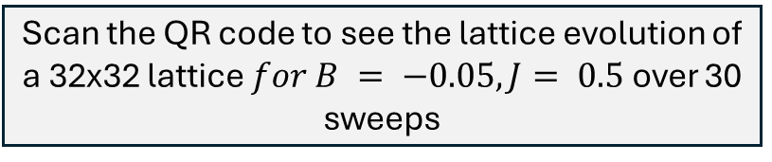
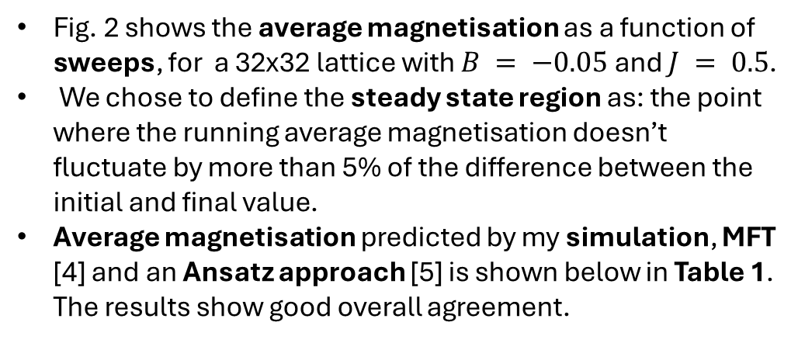
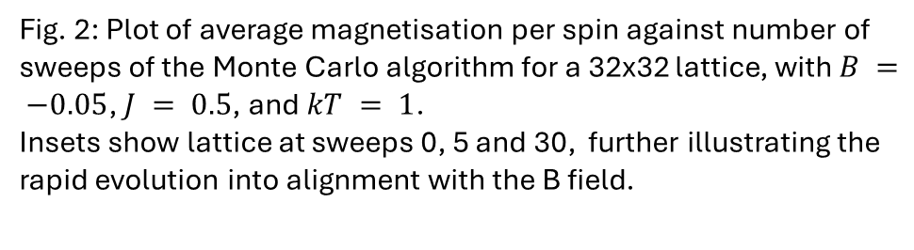
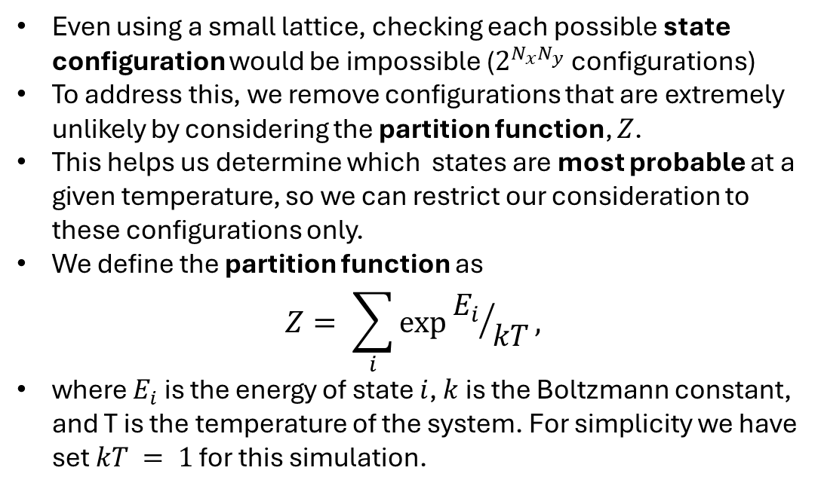
Modelling a ferromagnet using the Ising model
By Charlie Cook
Ferromagnets can be modelled using a simple 2D Ising model. Using this model, and Monte-Carlo methods (the metropolis algorithm), the average magnetisation in the steady state region is determined for a set of specific conditions, and compared to other models of ferromagnets, all showing good agreement with one another.
Introduction
 |  | 1
 | 4 |  | 2
 |  | 3
4. Results
Magnetism has long been central to technology, from early compasses to modern data storage.
Many models successfully described ferromagnetism, such as Mean Field Theory (MFT) and the Heisenberg model, but the Ising model stands out for its simplicity and analytical tractability.
Despite being simple, it captures key phenomena, such as phase transitions and critical temperatures, and is widely used even outside of physics e.g. to model financial markets.
In this project, the Ising model is used to calculate the average magnetisation (at steady state) of a lattice when placed in an external field
Fig. 1: Periodic lattice (i.e. edges wrap around) with randomly assigned spins. White = spin-up, Black = spin-down .
The four nearest neighbours of the centre square are shown using red borders and numbers.
Fig. 2 shows the average magnetisation as a function of sweeps, for a 32x32 lattice with $B = −0.05$and $J = 0.5$.
We chose to define the steady state region as: the point where the running average magnetisation doesn’t fluctuate by more than 5% of the difference between the initial and final value.
Average magnetisation predicted by my simulation, MFT [4] and an Ansatz approach [5] is shown below in Table 1. The results show good overall agreement.
2. Partition Function
Table 1: Average magnetisation predicted by different models. MFT prediction is slightly larger since it ignores thermal fluctuations.
Model | $$<m>$$
Ising model (simulation) | $$−0.936±0.003$$
Mean Field Theory | $$\sim −0.96$$
Ising model (Ansatz) | $$\sim −0.92$$
1. 2D Ising Model
Even using a small lattice, checking each possible state configuration would be impossible ($2^{N_{x}N_{y}}$configurations)
To address this, we remove configurations that are extremely unlikely by considering the partition function, $Z$.
This helps us determine which states are most probable at a given temperature, so we can restrict our consideration to these configurations only.
We define the partition function as
$$Z= \sum_{i}{exp⁡{E_{i}}/{kT}},$$
where $E_{i}$ is the energy of state $i$, $k$ is the Boltzmann constant, and T is the temperature of the system. For simplicity we have set $kT = 1$ for this simulation.
A periodic lattice of dimensions $N_{x}$ by $N_{y}$ is created.
Each point is randomly assigned a spin value, $S$, of either +1 (spin up) or -1 (spin down).
The total energy of the lattice comes from two sources [1,2] and is then given by:
$$E=−B\sum_{α}{S_{α}} −J\sum_{<αβ>}{S_{α}S_{β}},$$
where $α$ is the summation over each lattice point (i.e. over all $i$ and $j$), and$β$is the summation of the four nearest neighbours: $\left(i−1,j\right)$, $\left(i+1,j\right), (i ,j−1)$and $\left(i, j+1\right)$[2].
J is the interaction strength between neighbouring spins: J > 0 and J < 0 corresponding with the tendency for neighbouring spins to align (ferromagnetism) or anti-align (anti-ferromagnetism), respectively.
Average magnetisation of the lattice can be calculated using:
$$<m> =\frac{1}{N_{x}N_{y}}\sum_{α}{S_{α}}$$
Lattice evolution
(3)
(1)
0 Sweeps
5 Sweeps
30 Sweeps
External Field Contribution
Spin Interaction Contribution
3. Metropolis Algorithm
To update the lattice, we flip a chosen spin and calculate the resulting energy change, $ΔE=−2\left[Jf+B\right]S_{α}.$ We use this to gauge how likely this flip is to occur.
f is the sum of the four neighbouring spins.
The negative sign ensures that aligned spins correspond to lower energy.
We then decide whether to keep the flip using the Metropolis criterion:
If $\exp\left({ΔE}/{kT}\right)>1$keep the flipped spin
Otherwise, generate a random number, $n ∈ [0,1]$. If
$exp⁡(−ΔE/kT)>n$, keep the flip.
If neither condition is met, revert the flip back.
This procedure is repeated for every lattice point (a full sweep), using periodic boundary conditions. Together, these steps form the Metropolis algorithm [3].
Steady state region
Fig. 2: Plot of average magnetisation per spin against number of sweeps of the Monte Carlo algorithm for a 32x32 lattice, with $B = −0.05$, $J = 0.5$, and $kT = 1$.
Insets show lattice at sweeps 0, 5 and 30, further illustrating the rapid evolution into alignment with the B field.
(2)
6. References & AI statement
Scan the QR code to see the lattice evolution of a 32x32 lattice $for B = −0.05, J= 0.5$over 30 sweeps
Ising, E. Beitrag zur Theorie des Ferromagnetismus. Z. Physik 31, 253–258 (1925). https://doi.org/10.1007/BF02980577
Onsager, L. Crystal Statistics. I. A Two-Dimensional Model with an Order-Disorder Transition. Phys. Rev. 65, 117–149 (1944). https://doi.org/10.1103/PhysRev.65.117
Metropolis, N., Rosenbluth, A., Rosenbluth, M., Teller, A., and Teller, E. (1953). Equations of state calculations by fast computing machines. J. Chem. Phys., 21(6): 10871092.
Sakthivadivel, Dalton A. R. "Magnetisation and mean field theory in the Ising model." SciPost Physics Lecture Notes, vol. 35, 2022. arXiv, 2102.00960.
Alexanian, Moorad. "Ansatz for the Two-Dimensional Ising Model in an External Magnetic Field." Armenian Journal of Physics, vol. 17, no. 3, 2024, pp. 52–57. doi:10.54503/18291171-2024.17.3-52.
Generative AI in the form of ChatGPT was occasionally used to improve clarity of writing only.

Slide 9
Modelling a ferromagnet using the Ising model
By Charlie Cook
Ferromagnets can be modelled using a simple 2D Ising model. Using this model, and Monte-Carlo methods (the metropolis algorithm), we determine the average magnetisation in the steady state region for a set of specific conditions and compare to other models of ferromagnets, all showing good agreement with one another.
Introduction
 |  | 1
 | 4 |  | 2
 |  | 3
4. Results
Magnetism has long been central to technology, from early compasses to modern data storage.
Many models successfully described ferromagnetism, such as Mean Field Theory (MFT) and the Heisenberg model, but the Ising model stands out for its simplicity and analytical tractability.
Despite being simple, it captures key phenomena, such as phase transitions and critical temperatures, and is widely used even outside of physics e.g. to model financial markets.
In this project, the Ising model is used to calculate the average magnetisation (at steady state) of a lattice when placed in an external field
Fig. 1: Periodic lattice (i.e. edges wrap around) with randomly assigned spins. White = spin-up, Black = spin-down .
The four nearest neighbours of the centre square are shown using red borders and numbers.
Fig. 2 shows the average magnetisation as a function of sweeps, for a 32x32 lattice with B = -0.05 and J = 0.5.
We define the steady state region as the point where the running average magnetisation doesn’t fluctuate by more than 5% of the difference between the initial and final value.
Average magnetisation predicted by my simulation, MFT [4] and an Ansatz approach [5] is shown below in Table 1. Results are generally in agreement with each other.
2. Partition Function
Table 1: Average magnetisation predicted by different models. MFT prediction is slightly larger since it ignores thermal fluctuations.
Model | $$<m>$$
Ising model (simulation) | $$−0.936±0.003$$
Mean Field Theory | $$\sim −0.96$$
Ising model (Ansatz) | $$\sim −0.92$$
1. 2D Ising Model
Even using a small lattice, checking each possible state configuration would be impossible ($2^{N_{x}N_{y}}$configurations)
To address this, we remove configurations that are extremely unlikely by considering the partition function, $Z$.
This helps us determine which states are most probable at a given temperature, so we can restrict our consideration to these configurations only.
We define the partition function as
$$Z= \sum_{i}{exp⁡{E_{i}}/{kT}},$$
where $E_{i}$ is the energy of state $i$, $k$ is the Boltzmann constant, and T is the temperature of the system.
A periodic lattice of dimensions $N_{x}$ by $N_{y}$ is created.
Each point is randomly assigned a spin value, $S$, of either +1 (spin up) or -1 (spin down).
The total energy of the lattice comes from two sources [1,2] and is then given by:
$$E=−B\sum_{α}{S_{α}} −J\sum_{<αβ>}{S_{α}S_{β}},$$
where $α$ is the summation over each lattice point (i.e. over all $i$ and $j$), and$β$is the summation of the four nearest neighbours: $\left(i−1,j\right)$, $\left(i+1,j\right), (i ,j−1)$and $\left(i, j+1\right)$[2].
J is the interaction strength between neighbouring spins: J > 0 and J < 0 corresponding with the tendency for neighbouring spins to align (ferromagnetism) or anti-align (anti-ferromagnetism), respectively.
Average magnetisation of the lattice can be calculated using:
$$<m> =\frac{1}{N_{x}N_{y}}\sum_{α}{S_{α}}$$
Lattice evolution
0 Sweeps
5 Sweeps
30 Sweeps
External Field Contribution
Spin Interaction Contribution
3. Metropolis Algorithm
To update the lattice, we flip a chosen spin and calculate the resulting energy change, $ΔE=−2\left[Jf+B\right]S_{α}.$ We use this to gauge how likely this flip is to occur.
f is the sum of the four neighbouring spins.
The negative sign ensures that aligned spins correspond to lower energy.
We then decide whether to keep the flip using the Metropolis criterion:
If $\exp\left({ΔE}/{kT}\right)>1$keep the flipped spin
Otherwise, generate a random number, $n ∈ [0,1]$. If
$exp⁡(−ΔE/kT)>n$, keep the flip.
If neither condition is met, revert the flip back.
This procedure is repeated for every lattice point (a full sweep), using periodic boundary conditions. Together, these steps form the Metropolis algorithm [3].
Fig. 2: Plot of average magnetisation per spin against number of sweeps of the Monte Carlo algorithm for a 32x32 lattice, with B = -0.05, J = 0.5, and kT = 1.
Insets show lattice at sweeps 0, 5 and 30, further illustrating the rapid evolution into alignment with the B field.
6. References & AI statement
Scan the QR code to see the lattice evolution of a 32x32 lattice for B = -0.05, J= 0.5 over 30 sweeps
Ising, E. Beitrag zur Theorie des Ferromagnetismus. Z. Physik 31, 253–258 (1925). https://doi.org/10.1007/BF02980577
Onsager, L. Crystal Statistics. I. A Two-Dimensional Model with an Order-Disorder Transition. Phys. Rev. 65, 117–149 (1944). https://doi.org/10.1103/PhysRev.65.117
Metropolis, N., Rosenbluth, A., Rosenbluth, M., Teller, A., and Teller, E. (1953). Equations of state calculations by fast computing machines. J. Chem. Phys., 21(6): 10871092.
Sakthivadivel, Dalton A. R. "Magnetisation and mean field theory in the Ising model." SciPost Physics Lecture Notes, vol. 35, 2022. arXiv, 2102.00960.
Alexanian, Moorad. "Ansatz for the Two-Dimensional Ising Model in an External Magnetic Field." Armenian Journal of Physics, vol. 17, no. 3, 2024, pp. 52–57. doi:10.54503/18291171-2024.17.3-52.
Generative AI in the form of ChatGPT was occasionally used to improve clarity of writing only.

